Slide 1
Project Raytracer Developed by Thabo Thage Date March 2016

Slide 2
Description
The project attempts to create a realistic image using mathematics, physics and computer programming.
Linear Algebra and the C++ programming language were heavily used to render the images.
Effects such as realistic lighting, reflection and refraction were all implemented in the project.

Slide 3
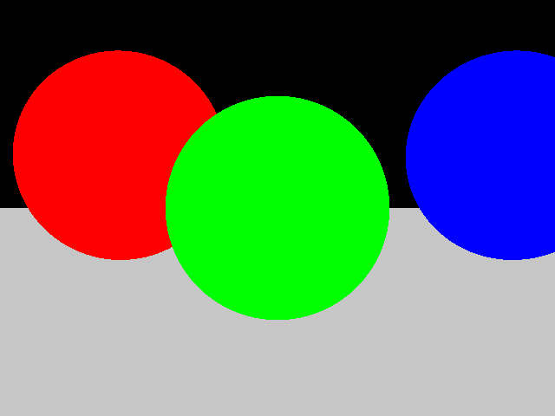
Simple image without any realistic lighting

Slide 4
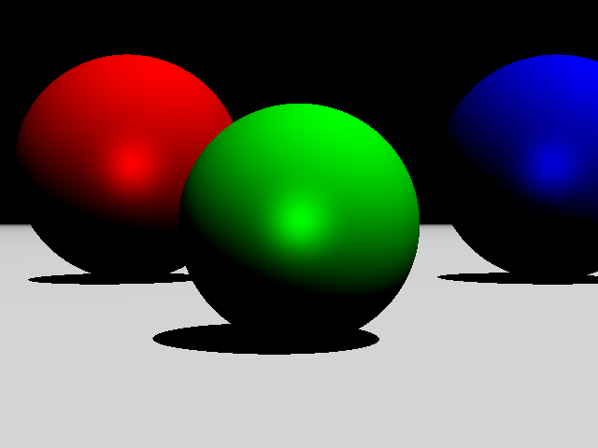
After applying the Phong lighting model to make the objects in the scene seem more realistic

Slide 5
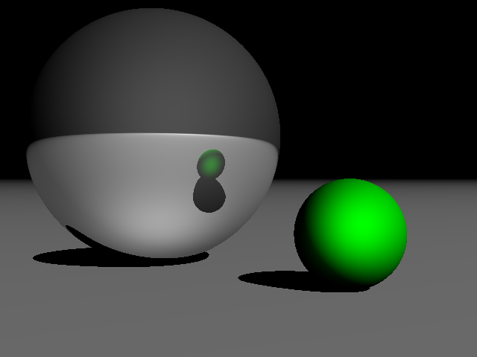
An image with reflection implemented

Slide 6
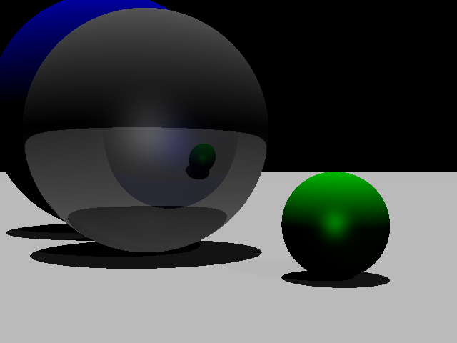
An image with both reflection and refraction implemented together with the application of a lighting model

